Slide 1
Assignment Review

Slide 2
Task 1
Task 1 - The Case Study: Present your case study based on the topic presented above. Present the overall requirements of such a website. (L.O.2., 400 words, 5%)
Background:
Bicycle rental service is becoming a popular business model in many cities for locals, tourist, business delivery, and higher education students. They are seen as a cheaper and more environmentally friendly option. Research and create a website that promotes a bicycle rental service. Focus on a small business model as opposed to large scale big business models.

Slide 3
Task 2
Task 2- Background Research: Review at least ten websites promoting businesses of the similar to your case study. Reflect on the design, usability, features (functionality) accessibility, and legal requirements of these websites. Present a summary of your analysis and a summarised tabular list of the websites you visited. (L.O.1. and L.O.7, 700 words, 10%)

Slide 4

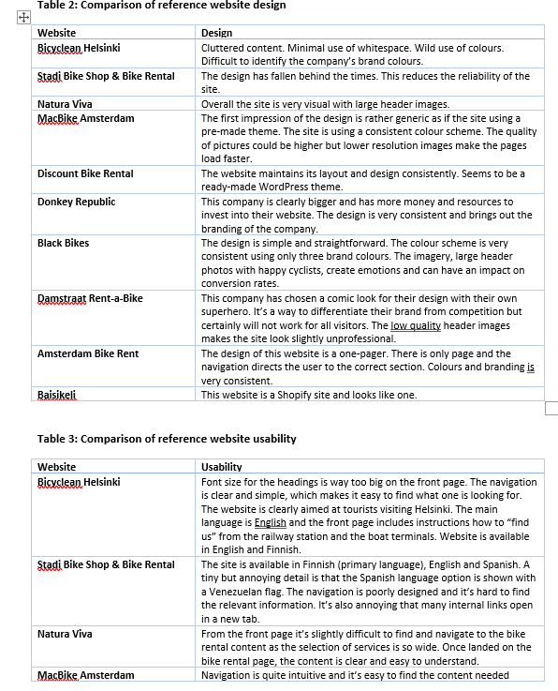
Review of the assignment
4

Slide 5
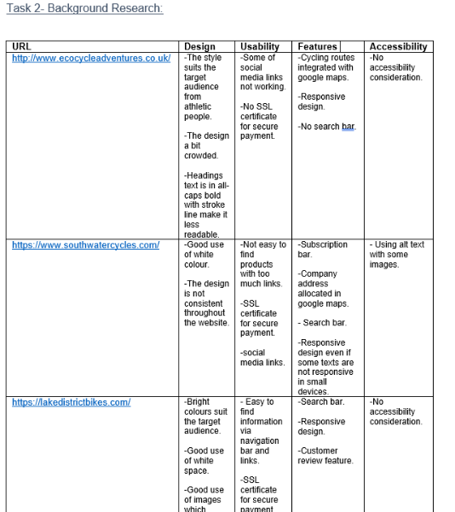
Review of the assignment
5

Slide 6
Task 3
Task 3- Web Planning: Using a defined approach to modelling, present a plan for your website to include design, usability, functionality, and accessibility features. Your plans should separate the design specification from the content. Make your web technologies recommendations, choice of URL, service provider, and method of implementation. (L.O.1. and L.O.2., 700 words, 20%).

Slide 7
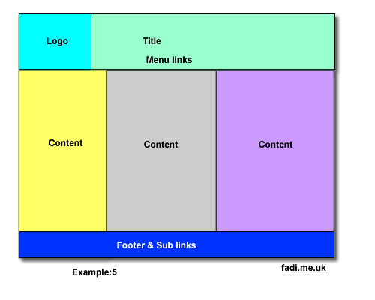
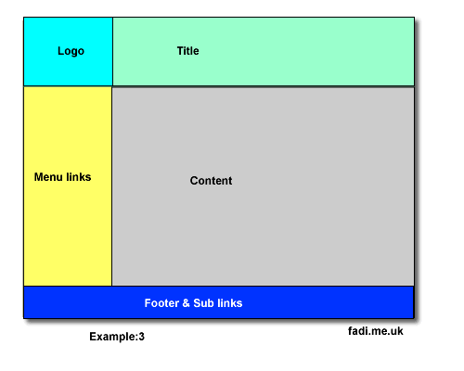
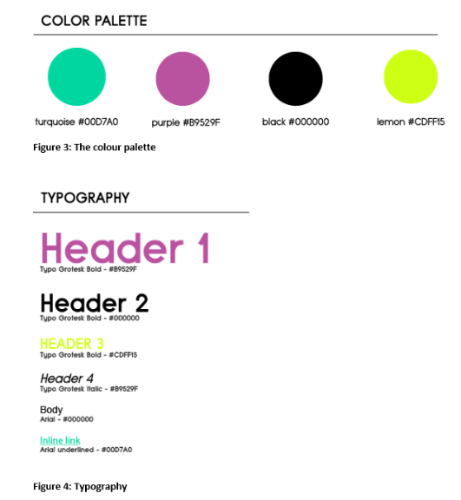
Task 3
Index
About Us
Our Products
Locate Us
Contact Us
Product1
Product2
Product3
Buy Now
Buy Now
Preorder
Login
Account
Balance
Logout
Index
About Us
Our Products
Locate Us
Contact Us
Quiz Home Page
Quiz 1
Quiz 2
Quiz 3
Quiz 4
Quiz 5

Slide 8
Task 4
Task 4- Implementation** and Testing: Implement your website and provide testing logs. You should provide screenshots of every page with an explanation of any design, usability, functionality, and accessibility features included. Label your screenshots appropriately. The HTML codes to be provided in the appendix. Ensure that the document is presented in a professional structure. The website needs to have the following elements: HTML, CSS, HTML comments, images, lists, forms, and navigation. Testing should include logs of each page as well as W3C validation reports. (L.O.3, L.O.4., and L.O.8, 700 words, 50%)
**Students are not allowed to use websites or software that generates for there assignment. For example, use of Wix, WordPress, Dreamweaver, or any software or templates. The use of these tools will be reported as breach of regulations.

Slide 9
Task 5
Task 5- Evaluation and Reflection: Evaluate your website site and reflect on your Background Research (Task 2). Suggest ways to optimise your website using search engines, mobile accessibility, advertising revenues, and local exposure. (L.O.5. and L.O.6, 500 words, 15%).

Slide 10
Final word:

